Slide 1
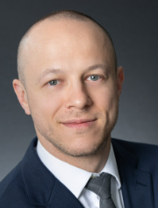
Panelists
Sean Burke
PGIM Real Estate
sean.j.burke@pgim.com
Tracey Easton
Moore & Van Allen
traceyeaston@mvalaw.com
Alex Zeltser
Tiber Hudson
alex@tiberhudson.com

Slide 2
Multifamily Volume Cap Scarcity
NH
ME
VT
OR
MA
RI
CT
Undersubscribed (15 states)
NJ
IN
DE
MD
Parity (12 states)
DC
Oversubscribed (23 states & Washington, D.C.)
Information as of April 2025
Source: Tiber Hudson; Novogradac
HI
Copyright © 2025 Tiber Hudson LLC

Slide 3
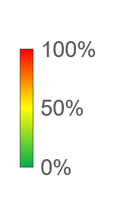
Est. Multifamily Spending as a Percentage of Total PAB Allocation
ND
< 5%
ME
41%
OR
18%
SD
22%
WY
7%
NE
27%
IA
< 5%
IN
28%
State | Est. %
Vermont | < 5%
New Hampshire | < 5%
Massachusetts | < 5%
Rhode Island | 18%
Connecticut | 15%
New Jersey | 25%
Delaware | 7%
Maryland | 51%
Hawaii | 77%
CO
49%
AR
< 5%
MS
5%
LA
52%
AK
5%
Copyright © 2025 Tiber Hudson LLC

Slide 4
Important Market Indicators

Slide 5
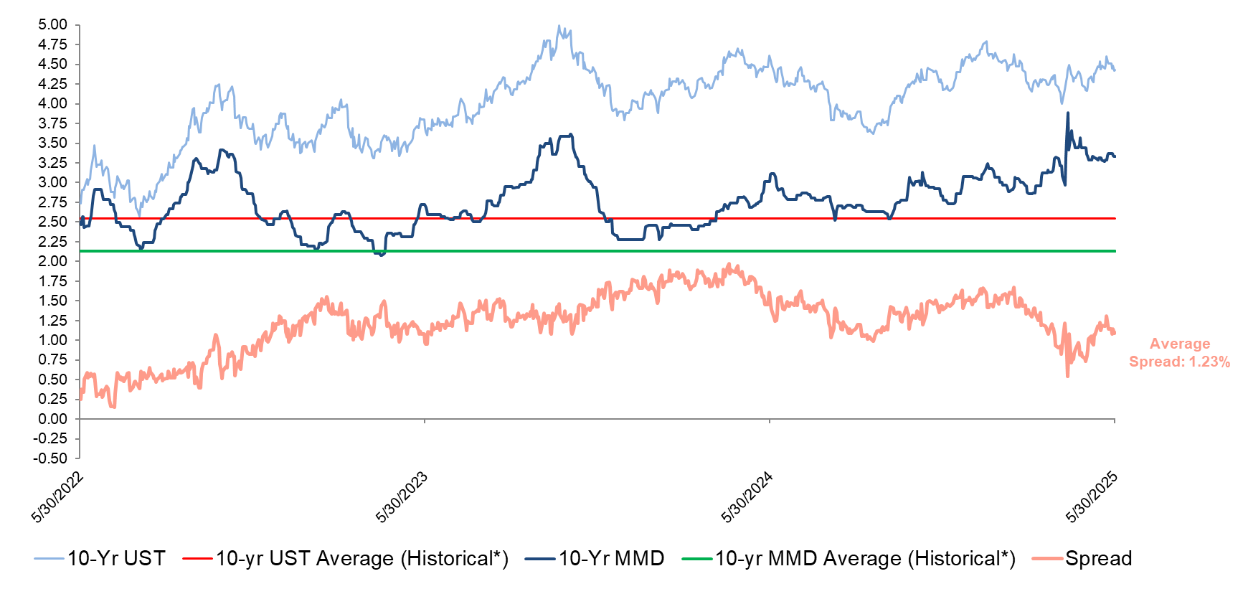
Long-Term Rates – Past 3 Years 10 YR UST vs 10 YR MMD
Source: Bloomberg. Thomson Reuters
Reflects market conditions as of May 30, 2025
Thomson Reuters Municipal Market Data (MMD) AAA curve is a proprietary yield curve that provides the offer-side of AAA rated state general obligation bonds
*From January 1, 2010 to Current
5

Slide 6
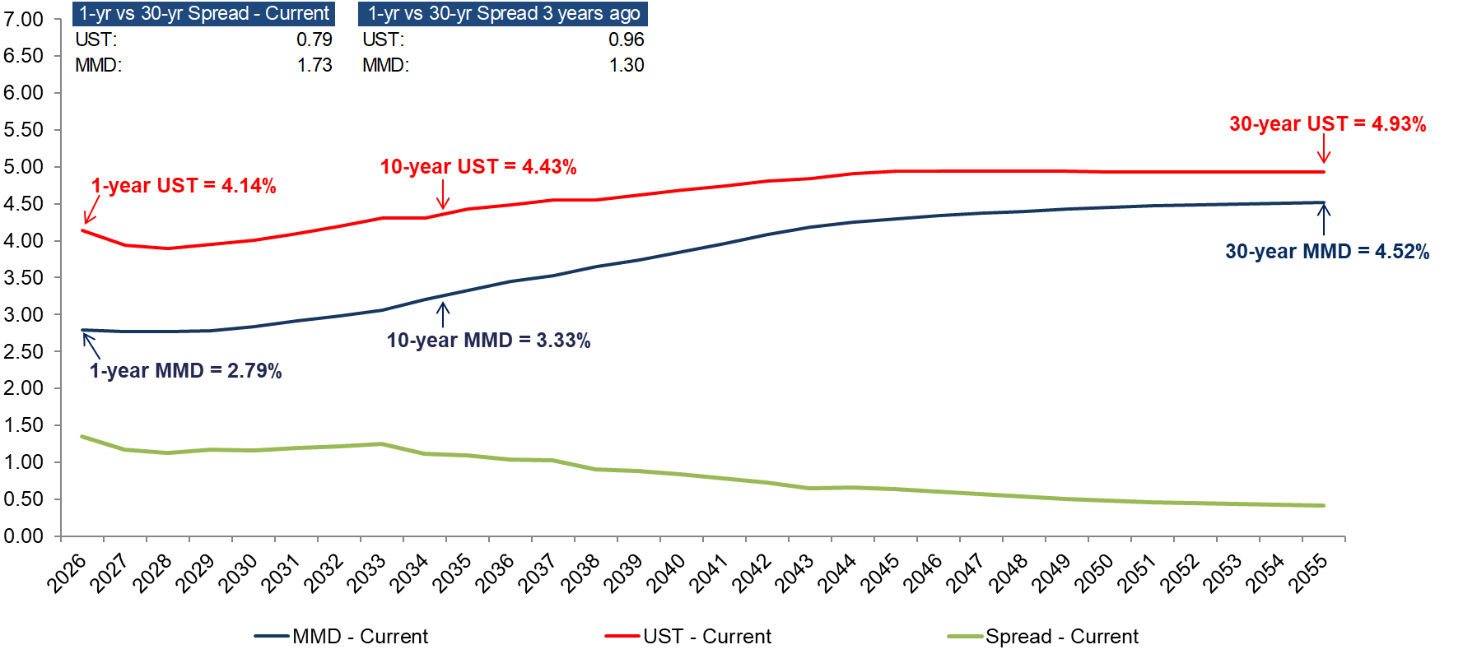
Yield Curve: Taxable UST vs. Tax-Exempt MMD (as of 5/30/2025)
Source: Bloomberg. Thomson Reuters
Reflects market conditions as of May 30, 2025
Thomson Reuters Municipal Market Data (MMD) AAA curve is a proprietary yield curve that provides the offer-side of AAA rated state general obligation bonds
6

Slide 7
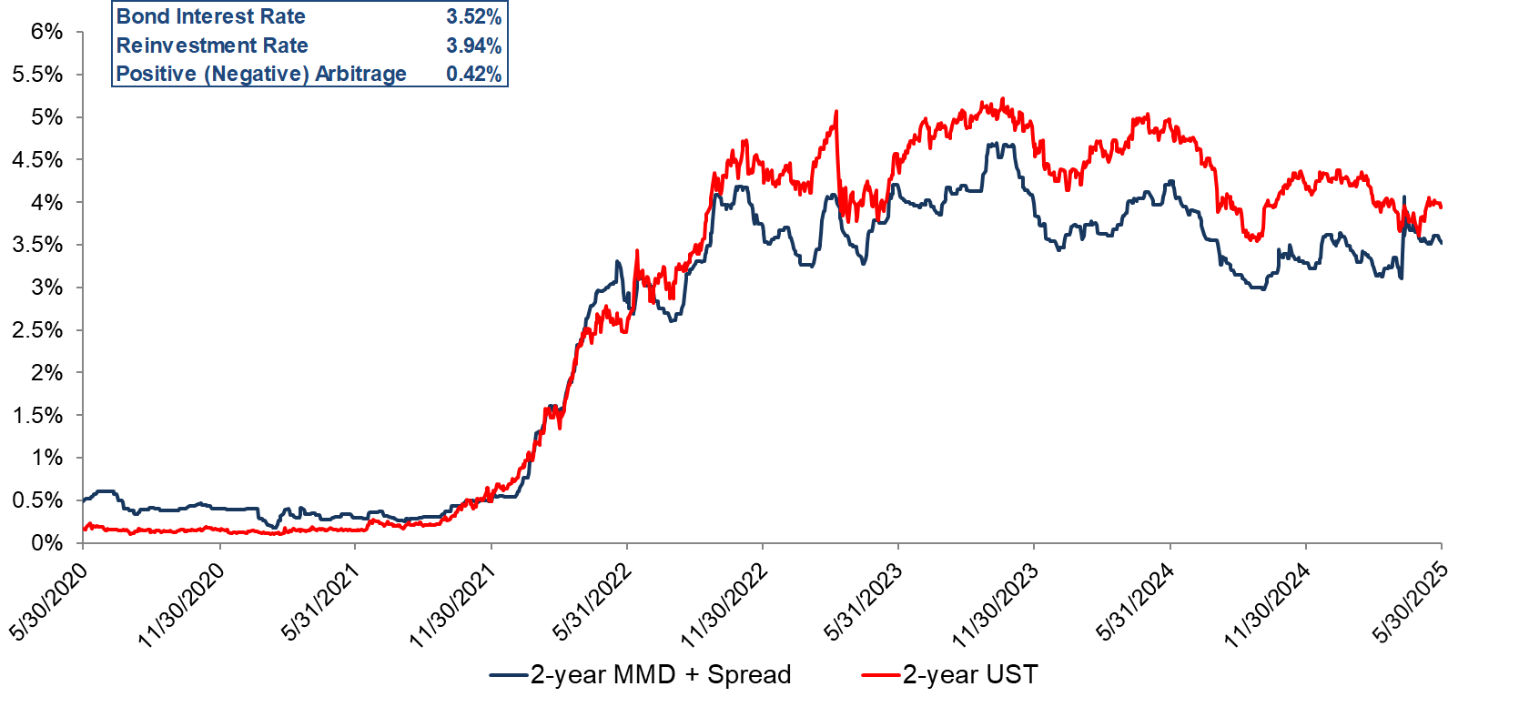
2-Year Short-Term Yield Curves Past 5 Years
Source: Bloomberg. Thomson Reuters
Reflects market conditions as of May 30, 2025
Thomson Reuters Municipal Market Data (MMD) AAA curve is a proprietary yield curve that provides the offer-side of AAA rated state general obligation bonds
7

Slide 8
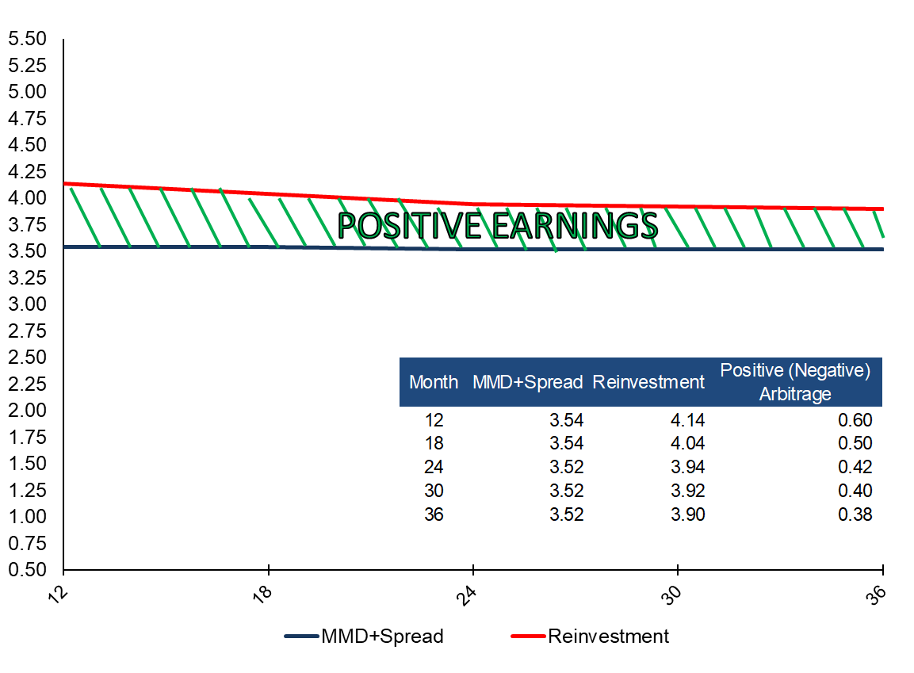
Short-Term Rates vs. Reinvestment Rates – 12 to 36 Months
Source: Bloomberg. Thomson Reuters
Reflects market conditions as of May 30, 2025
Thomson Reuters Municipal Market Data (MMD) AAA curve is a proprietary yield curve that provides the offer-side of AAA rated state general obligation bonds
8

Slide 9
Taxable Debt Executions with Short Term Cash-Backed Bonds

Slide 10
Short Term Cash-Backed Bonds with Taxable Perm Loan
Taxable construction and/or perm loans still available in the current market at competitive rates including:
FHA/GNMA (221(d)(4) / 223(f))
Rural development (538 / 515)
Fannie loans (mod/light in-place rehab)
Other (taxable) state and/or local loan programs
Soft funds (including CDBG, FEMA, etc.)
DOT/TIFIA (transit-oriented developments)
Copyright © 2025 Tiber Hudson LLC
10

Slide 11
Short Term Cash-Backed Bonds with FHA Credit Enhancement
Favorable underwriting terms for FHA loans (223(f)/221(d)(4)) include:
35/40-year full term / amortization
No resizing at conversion
Non-recourse & integrated construction and perm
Taxable mortgage loan is funded as needed for sub rehab / new construction deals
FHA debt qualifies for 10-year hold exemption (for acquisition credits)
Competitive rates still available
Davis Bacon wages triggered for sub rehab / new construction deals
Copyright © 2025 Tiber Hudson LLC
11

Slide 12
Bond Executions with FHA Credit Enhancement
4% Low Income Housing Tax Credits: The 50% Test
Project needs tax exempt bonds to qualify for 4% Low Income Housing Tax Credits
At least 50% of aggregate basis (including building and land) must be financed with tax exempt bond proceeds
Provides a significant (~30% or higher) additional source of funds for affordable housing transactions
Can be used independently or with other “longer term” bond structures to meet 50% test
Copyright © 2025 Tiber Hudson LLC
12

Slide 13
Short Term Cash-Backed Bonds
Borrower
Bond Proceeds
LP Investor
Debt Service
Payments
Trustee
Bond
Proceeds
Cash
Collateral
Lender
Funds
Bond Holders
Perm
Lender
Copyright © 2025 Tiber Hudson LLC

Slide 14
Short Term Cash-Backed Bonds
Bond amount to meet 50% test < Taxable loan amount
No additional collateral needed!
Bond amount to meet 50% test > Taxable loan amount
Need other collateral sources of funds including:
Subordinate loan proceeds
Seller note
Tax credit equity bridge
Copyright © 2025 Tiber Hudson LLC
14

Slide 15
Cash-Backed Forward Structure

Slide 16
Cash-Backed Forward
Works with any tax-exempt financing that involves a forward commitment from a permanent lender to purchase the debt at conversion
Takes advantage of inverted yield curve and provides other significant benefits
Provides positive earnings during cash-backed mode, as well as additional equity to the project*
Allows equity investor to also serve as construction lender without certain tax implications
In Texas, significantly reduces interest costs on construction loan due to draw down structure
*** Subject to approval from Bond Counsel and Developer’s accounting firm
Copyright © 2025 Tiber Hudson LLC

Slide 17
Cash-Backed Forward
Upon Conversion
Borrower
Bond
Proceeds
Trustee
Bond
Debt Service
Payments
Tax Exempt Bonds
Lender
Funds
Permanent Lender
Bond
Proceeds
Cash
Collateral
Initial Cash-Backed Bond Holder
Construction Lender
Equity Investor

Slide 18
Cash-Backed Forward Benefits
18

Slide 19
Cash-Backed Forward Yield Blending
Permanent Loan Rate = 6.25%
Positive earnings during cash-backed mode (subject to bond counsel approval to blend yields)
“Yield Blending” refers to the ability to blend the short-term bond yield with the long-term bond/note yield over the first 5 years for arbitrage rebate purposes.
The resulting blended bond yield often results in the ability to retain certain earnings at or below such rate (subject to bond counsel approval).
Investment Yield = 3.75%
Short Term Bond Rate = 3.15%
Blended Bond Yield
5-Year Mark:
Blended Bond Yield = 4.21%
Retainable Earnings: $540,000
Owed to IRS: $0
Positive Earnings
IMTD:
Blended Bond Yield = 3.15%
Retainable Earnings: $0
Owed to IRS: $540,000
Retainable Earnings
* Assumes $30mm bond par amount and 3-year initial term
Copyright © 2025 Tiber Hudson LLC

Slide 20
Cash-Backed Forward Benefits
Additional equity generated when counting bond interest through completion in eligible basis*
Bond Interest:
$1.9mm
Construction Loan Interest:
$2.2mm
Additional Equity:
$665,000
Equity:
$775,000
Equity:
$775,000
Est. Savings: $665,000
******Inclusion of bond and construction loan interest subject to approval from developer’s accounting firm.
******Assumes $30mm par amount and 3-year initial term to conversion, 24-month construction period, with level draw schedule.
******Equity generated assumed to be 35% of interest cost through completion. Confirm impact of investment income with equity investor
******Additional equity generated from taxable construction loan interest in situations where equity investor and construction lender are not related parties
Copyright © 2025 Tiber Hudson LLC

Slide 21
Possible Added Costs Of Cash-Backed Forward*
Additional costs of issuance for publicly offered bonds
Expense | Est. Cost
Underwriter’s Fee | $180,000
Underwriter’s Counsel | $60,000
Rating Agency | $5,500
Verification Agent | $2,500
Other Costs | $2,000
Additional Equity Generated from COI
Total Estimated COI | $250,000
Est. Additional Basis** | $166,666
Est. Additional Equity*** | $60,000
Est. Net Expense: $190,000
* Possible added cost from taxable construction loan interest in situations where equity investor and construction lender are not related parties
*** A portion of costs of issuance allocable to the cash-collateralized bond issue can count towards eligible basis, pro rated for the portion of the initial term prior to construction completion
*** Additional equity is assumed to be 35% of additional basis
Copyright © 2025 Tiber Hudson LLC

Slide 22
Cash-Backed Forward Comparison
Summary of Overall Structure
 | Standard Draw-Down Bond Structure | Cash-Backed Forward | Savings*
Est. Positive Earnings | $0 | $540,000 | $540,000
Est. Additional Equity | $775,000 | $1,440,000 | $665,000
Est. Additional Costs of Issuance | $0 | ($190,000) | ($190,000)
Est. Savings: $1,015,000
3.38% of Bond Amount**
* Lower savings in situations where equity investor and construction lender are not related parties
** Assumes $30mm bond amount
Copyright © 2025 Tiber Hudson LLC

Slide 23
23

Slide 24
GSE Credit Enhanced 4% Bond Structures

Slide 25
Combine MTEB with Additional Fannie Mae Products for Maximum Value
Green Rewards
HEALTHY HOUSING REWARDS
Premium Bonds
WorkFORCE HoUsing
Cost Of issuance reimbursement
Copyright © 2025 Tiber Hudson LLC
25

Slide 26
Fannie Mae M-TEB/BCE Overview
Flexible interest-only period; 35-year amortization (40 years for some deals)
Total bonds issued in the amount equal to the greater of:
Permanent loan – no other series of tax-exempt bonds needed
55% of aggregate basis – second cash-backed or other series of tax-exempt bonds needed
Seller note, equity, or other soft funds can be used to securitize cash-backed bonds
Taxable supplemental or tax-exempt earn-out available
Fully integrated bond and underwriting documents developed by Tiber Hudson can be utilized
Copyright © 2025 Tiber Hudson LLC
26

Slide 27
Fannie Mae M-TEB/BCE Overview
Fannie Mae / Lender provides forward commitment
Hybrid structure (Immediate/Forward) available for some mod/sub rehab deals
For new construction or sub-rehab deals – Construction lender needed prior to conversion
Bonds initially secured by cash collateral and construction loan funds, then replaced at conversion with MBS
Negative arbitrage on perm amount prior to conversion
Yields can often be blended to reduce or eliminate total negative arbitrage for the deal)
Fannie to credit 75 bps for bond related costs
Paid upon conversion
Competitive rates available: Often results in additional net loan proceeds despite some upfront costs

Slide 28
Fannie Mae Forward M-TEB
Upon Conversion
Borrower
Bond
Proceeds
MBS Pass Through Payment
Trustee
Mortgage
Payments
Tax Exempt Bonds
Bond Payments
Lender
Funds
Permanent Lender
Bond
Proceeds
Cash
Collateral
Bond Holder
Construction Lender
Equity Investor
Copyright © 2024 Tiber Hudson LLC

Slide 29
Forward Bond Credit Enhancement
Upon Conversion
Borrower
Bond
Proceeds
Monthly CE Payment
Credit Enhancement Instrument
Trustee
Monthly Reimbursement
Tax Exempt Bonds
Semiannual Bond Payments
Lender
Funds
Bond
Proceeds
Cash
Collateral
Bond Holder
Credit Enhancement Provider
Construction Lender
Equity Investor
Copyright © 2024 Tiber Hudson LLC

Slide 30
Forward M-TEB / BCE Benefits
30

Slide 31
Forward M-TEB / BCE Benefits
Yield blending (subject to bond counsel approval) often results in ability to offset a portion of long-term bond interest cost with excess earnings on the short-term bonds
Additional equity generated when counting bond interest through completion in eligible basis*
Potential for greater permanent loan proceeds in debt service constrained transactions
Earnings on bond proceeds count towards 50% test
If bond amount > perm loan, allows other funds to be used as collateral (reduced construction loan)
Allows equity investor to also serve as construction lender without triggering program investment test
* Inclusion of bond and construction loan interest subject to approval from Developer’s accounting firm.
31

Slide 32
M-TEB / BCE Benefits
Potential for greater permanent loan proceeds in debt service constrained transactions*
 | Standard Bond Structure | Forward M-TEB/BCE
Est. Mortgage Rate | 6.00% | 5.70%
Est. Annual Payment | $1,270,000 | $1,270,000
Est. Loan Proceeds | $19,250,000 | $20,000,000
Est. Additional Proceeds = $750,000
****** Assumes 1.15x DSCR, 40-year amortization, $1.4mm NOI
Copyright © 2025 Tiber Hudson LLC

Slide 33
M-TEB / BCE Yield Blending
No Yield Blending (Separate Issues)*:
Under the M-TEB structure that includes a second, short-term series of bonds*, “Yield Blending” refers to the ability (subject to bond counsel approval) to blend the yield on the long-term bonds with the yield on the short-term bonds over the initial computation period for arbitrage rebate purposes.
If the GSE is not involved in purchasing the tax credits, guarantee fee is typically included in the long-term bond yield calculation.
The resulting blended bond yield often results in the ability to offset a portion of the long-term bond interest cost (if applicable) with excess earnings on the short-term bonds.
Interest Cost (Series A): $450,000
Due to IRS (Series A): $0
Total Cost: $450,000
Interest Earnings (Series B): $75,000
Due to IRS (Series B): $75,000
With Yield Blending (Single Issue)*:
* Also applicable for Risk-Share transactions with two series
Total Cost: $375,000
Est. Net Savings: $75,000
Copyright © 2025 Tiber Hudson LLC
* Assumes $20mm Series A par, $10mm Series B par, and 36-month initial term

Slide 34
M-TEB / BCE Yield Blending*
Forward M-TEB / BCE
 | Series A: | Series B:
Bond Amount | $20,000,000 | $10,000,000
Est. Bond Yield | 4.80% | 3.15%
Est. Investment Yield | 3.75% | 3.75%
Est. Bond Interest | $2,880,000 | $945,000
Est. Investment Income | ($2,250,000) | ($1,125,000)
Est. Net Cost | $630,000 | ($180,000)
Net Cost with Yield Blending = $450,000
Net Cost without Yield Blending = $630,000
* Assumes 3-year initial term where applicable, subject to bond counsel approval
Copyright © 2025 Tiber Hudson LLC

Slide 35
Forward M-TEB / BCE Benefits
Additional equity generated when counting bond interest through completion in eligible basis*
Bond Interest:
$2.55mm
Construction Loan Interest:
$2.2mm
Construction Loan Interest:
$2.2mm
Additional Equity:
$900,000
Equity:
$775,000
Equity:
$775,000
Est. Savings: $900,000
****** Inclusion of bond and construction loan interest subject to approval from developer’s accounting firm.
****** Assumes 36-month initial term and 24-month construction/rehab period.
******Equity generated assumed to be 35% of interest cost through completion. Confirm impact of investment income with equity investor
******Additional equity generated from taxable construction loan interest in situations where equity investor and construction lender are not related parties
Copyright © 2025 Tiber Hudson LLC

Slide 36
Possible Added Costs Of Forward M-TEB / BCE *
Additional costs of issuance for publicly offered bonds
Expense | Est. Cost
Underwriter’s Fee | $215,000
Underwriter’s Counsel | $65,000
Rating Agency | $20,000
Verification Agent | $3,500
Other Costs | $1,500
Additional Equity Generated from COI
Total Estimated COI | $305,000
Est. Additional Basis** | $35,000
Est. Additional Equity*** | $10,000
Est. Net Expense: $295,000
* Possible added cost from taxable construction loan interest in situations where equity investor and construction lender are not related parties
Copyright © 2025 Tiber Hudson LLC

Slide 37
Forward M-TEB / BCE Comparison
Forward MTEB / BCE
 | Standard Bond Structure | Forward M-TEB | Savings
Est. Permanent Loan Proceeds | $19,250,000 | $20,000,000 | $750,000
Est. Negative Arbitrage | $0 | ($450,000) | ($450,000)
Est. Additional Equity | $775,000 | $1,675,000 | $900,000
Est. Additional Costs of Issuance | $0 | ($295,000) | ($295,000)
Est. Net Proceeds: | $20,025,000 | $20,930,000 | $905,000
Est. Savings: $905,000
3.01% of Bond Amount**
* Lower savings in situations where equity investor and construction lender are not related parties
** Assumes $30mm bond amount required to meet 50% test
Copyright © 2025 Tiber Hudson LLC

Slide 38
38

Slide 39
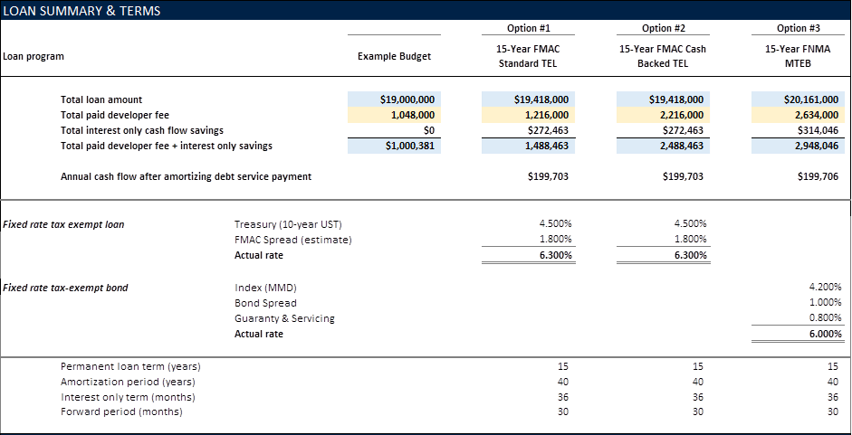
Increasing Deferred Developer Fee

Slide 40
Increasing Deferred Developer Fee

Slide 41
Additional Benefits from Cash Collateralized Bonds on 4% Deals
41

Slide 42
Cash-Backed Forward Other Benefits
Earnings on bond proceeds count towards 50% test
Standard Bond Structure:
Tax-Exempt Bonds
$30,000,000
53.0%
Aggregate Basis
$56,600,000
Cash-Backed Structure:
Tax-Exempt Bonds + Earnings on Bond Proceeds
$30,000,000 + $1,075,000
53.1%
Aggregate Basis + Bond Interest Through Completion
$56,600,000 + $1,900,000
Without Bond Interest in Basis:
Tax-Exempt Bonds + Earnings on Bond Proceeds
$30,000,000 + $1,075,000
54.9%
Aggregate Basis
$56,600,000

Slide 43
Cash-Backed Forward Other Benefits
If bond amount > perm loan, allows other funds to be used as collateral (reduced construction loan)
If instead of a $30mm construction loan collateralizing the bonds, $6mm of collateral came in the form of a cheaper source of funds, then the net interest cost could reduce by roughly $500k.
Copyright © 2024 Tiber Hudson LLC

Slide 44
Cash-Backed Forward Other Benefits
Allows equity investor to also serve as construction lender without triggering program investment test*, which is triggered when total issuer fees exceed 12.5 bps annually.
Standard Bond Structure
Bondholder: | Equity Investor:
Construction Lender | Construction Lender
Cash-Backed Forward
Bondholder: | Equity Investor:
Public Investors | Construction Lender
* Program Investment Test limits yield on loan (reflected in the issuer fee) to 0.125% in excess of yield on bonds on an annual basis for the full term of the bonds.
Copyright © 2025 Tiber Hudson LLC

Slide 45
Contact Information
Sean Burke
PGIM Real Estate
sean.j.burke@pgim.com
Tracey Easton
Moore & Van Allen
traceyeaston@mvalaw.com
Alex Zeltser
Tiber Hudson
alex@tiberhudson.com

Slide 46
Interested in more information?
Follow the QR code below to request a copy of these slides and various other informational materials from Tiber Hudson, or to schedule a free bond training session with our team.

Slide 47
Disclaimer
Copyright © 2025 Tiber Hudson LLC
This presentation may not be shared, reprinted, or reproduced without the express written consent of Tiber Hudson LLC.
The materials in this slide deck are presented for informational purposes only and do not constitute legal, tax or investment advice. Readers contemplating any of the transactions described herein should consult their legal, tax and investment advisors as necessary.
47

