Slide 1
Capitol Currents: Tracking Housing Policy Through Changing Terrain
Jennifer Schwartz | Director of Tax and Housing Advocacy
National Council of State Housing Agencies

Slide 2

The Federal Environment for Housing
2026 is year two of the 119th Congress: Republican trifecta with control of both chambers of Congress (extremely slim majority in House) and the White House
One Big Beautiful Bill Act, enacted in July 2025, expanded the Housing Credit by providing a 12% increase in 9% Credit authority and enactment of the 25% bond financing threshold for 4% developments
Major congressional focus on housing policy legislation as Congress works to advance the 21st Century ROAD to Housing legislation
FY 2027 Appropriations process underway

Slide 3
2026: The Year Ahead
January
February
March
April
May
June
July
August
September
October
November
December
September 30:
End of FY 2026
November 3:
Midterm elections
February to end of June:
Action on housing authorizing legislation
Mid-November
to end of year:
Lame Duck session: Possible tax action
February 3: FY 2026 Consolidated Appropriations Act enacted
Mid-April to end of July:
FY 2027 Appropriations Committee Action
April 3: President’s FY 2027 Budget Request Released

Slide 4

Housing Authorization Policy

Slide 5
The Road We’re On…
July 2025: Senate Banking Committee passes ROAD to Housing Act (24 – 0)
October 2025: ROAD added to Senate defense authorization bill and passed full Senate, but ultimately removed after objections from House
December 2025: House Financial Services Committee passes Housing for the 21st Century (50 – 1)
February 2026 Full House passage of Housing for the 21st Century (390 – 9)
What’s Next?
Formal conference?
Continued informal negotiation?
Senate takes up House bill?
May 2026: House Releases new version of 21st Century ROAD to Housing Act; Bill passes full House (396-13)
March 2026: Senate Banking Committee releases hybrid bill– 21st Century ROAD to Housing Act; Bill passes full Senate (89 – 10)

Slide 6
21st Century ROAD to Housing Act
Highlights of the Bills | House Version | Senate Version | Notes on Differences
Enacts the Administration’s proposal to limit institutional investor purchases of single-family homes with caveats | Yes | Yes | While both bills seek to limit institutional investor purchases, the House bill does not include the Senate’s 7-year disposition requirement.
Permanently authorizes HOME program with reforms to eliminate barriers to homeownership, streamline Section 3 requirements, simplify HOME property inspections, Allow HUD to forgive repayment if a property is no longer financially viable for reasons beyond an owners control, streamlining CHDO requirements, codify elimination of HOME commitment deadline, codify returning unused CHDO funds to the PJ’s HOME trust fund, and more | Yes | Yes | House version also streamlines HOME environmental rules to prevent duplicative reviews and directs the HUD Secretary to review and revise Build America, Buy America requirements
Raises the cap on banks’ public welfare investments (like affordable housing) from 15% to 20% of capital and surplus | Yes | Yes | House also requires a study every 2 years on PWI investments

Slide 7
21st Century ROAD to Housing Act
Highlights of the Bills | House Version | Senate Version
Modernizes rural housing programs, including codifying Section 515 decoupling pilot and requiring USDA and HUD to collaborate on environmental review rules | Yes | Yes
Streamlines environmental review process | Yes | Yes
Authorizes the Whole Home Repairs pilot program | Yes | Yes
Permanently reauthorizes PRICE program to preserve, maintain, & stabilize manufactured housing communities | No | Yes
Lifts RAD cap and makes program permanent | No | Yes
Permanently authorizes CDBG-DR program | No | Yes

Slide 8
Institutional Investor Ban
Both House and Senate bills:
Prohibit large institutional investors owning 350 or more single-family homes from purchasing additional single-family properties
Applicable properties are 1- or 2-unit dwellings
Senate Bill:
Exempts “Build-to-Rent” properties– But investors in such properties must still sell BTR homes within seven years
Creates a problem for Housing Credit single-family rental properties, as 7-year disposition requirement conflicts with tax code requires 30 years of affordability as rental housing
Same problem for other affordable housing BTR that requires more than 7 years as affordable rental housing
House Bill:
Does not require investors to sell any single-family home purchased before or after enactment. Investors who violate the prohibition would be subject to a civil penalty that would be funneled to HOME homeownership activities.
While the final House bill does not include an explicit exemption for housing financed with the Housing Credit, other exemptions from the rule ensure that the Housing Credit is not impacted

Slide 9
Lifting the Public Welfare Investment Cap
Lifting the PWI cap would allow banks to invest billions more in the Housing Credit
Banks can hold PWIs of up to 5 percent of risk-adjusted capital and surplus, which can increase to 15 percent with approval from primary regulator
Senate and House standalone bills to lift the PWI cap have been introduced
Affordable Housing Tax Credit Coalition, Affordable Housing Investors Council and National Association of Affordable Housing Lenders PWI Survey Results
22 banks responded to the survey, representing over $14 billion of investment in the Housing Credit in 2024 (nearly 2/3 of all investment in the Housing Credit)
$6.1 billion (over 42 percent) of investments came from banks nearing 15 percent PWI cap
$5.8b
$9.1b
$7.9b
Total PWIs
$28.9b
LIHTCs
$23.1b
Responses
$14b
LIHTC
$23.1b
$6.1b (more than 42%) came from banks that are nearing their 15% PWI cap
Survey respondents
$14b

Slide 10
Reforming the HOME program
Reauthorization
Eliminating barriers to using HOME to support homeownership
  HOME may be used to purchase, rehabilitate, and build for-sale housing valued at up to 110% of area median purchase price (now at 95%)
  Raises income eligibility to 100% of AMI for homeownership activities only
  Streamlines “resale” option to preserve affordable for-sale properties
  Provides flexibility for military/national guard members who need to sell and to heirs of HOME-assisted owners who have passed away even if the heir is not otherwise eligible
  Supports the use of HOME by Community Land Trusts
Streamlines Section 3 application to HOME
Simplifies HOME property inspections for states

Slide 11
Reforming the HOME program
Allows HUD to forgive repayment if a property is no longer financially viable for reasons beyond the PJ’s or owner’s control
Streamlines CHDO requirements
Codifies provisions from annual appropriations bills
Expands HOME-eligible activities to include certain infrastructure activities
Provides flexibility for small projects
House bill would also require the HUD Secretary to review and revise BABA guidance and eliminate duplicative environmental reviews.
Senate bill does not include these reforms

Slide 12


Slide 13
Trump Administration’s FY27 Budget
The President proposes and disposes… A presidential budget request outlines administration policy priorities but has no binding legal power. Congress makes the ultimate decisions related to funding levels and statutory policy direction.
$73.5 billion for HUD, $10.7 billion less than FY 26 enacted level (13% cut)
Eliminates funding for HOME, CDBG, CoC homeless assistance, FSS, HOPWA, Self-Help and Assisted Homeownership, Preservation and Reinvestment Initiative fore Community Enhancement, Pathways to Removing Obstacles (PRO) to Housing, Housing Counseling, and Fair Housing Activities.
Does not call for block granting and cutting of rental assistance programs; instead, proposes $38.8 billion for vouchers (increase of $407 million) and $17.6 billion for project-based renal assistance (cut of $903 million)
Continues rural housing decoupling program for an additional 5,000 units

Slide 14


FY27 HUD Appropriations
House Appropriations Committee marked up THUD bill on June 3
  $500 million for HOME ($750 million less than FY26)
  $28.083 billion for HCV ($356 million less than FY26)
  $18.975 billion for PBRA ($432 million more than FY26)
  $4.161 billion for Homeless Assistance Grants ($256 million less than FY26)
Senate mark-up of THUD TBD; Chair Collins intends to mark up all 12 bills by end of July

Slide 15
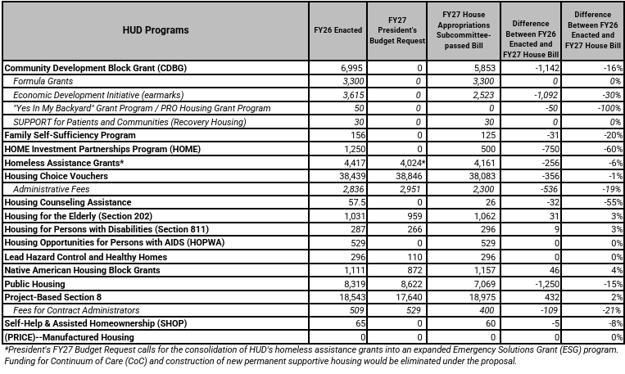
Budget Chart for Select U.S. Department of Housing and Urban Development (HUD) Programs (numbers in millions)

Slide 16
FY 27 Spending Asks
HOME Investment Partnerships program: At least $1.5 billion
Project-Based Section 8 Rental Assistance: Fully fund Section 8 contract renewals and provide adequate funding for contract administration.
Housing Choice Vouchers: Provide sufficient funding to renew all authorized vouchers and support new ones.
Congress also should ensure Section 8 program administrators are compensated fairly for their work with adequate administrative fees, which have been underfunded in recent years.
USDA Rural Housing: Provide at least level funding for USDA’s rural housing programs.

Slide 17


Slide 18
OB3 Review: Housing Highlights
What’s In
Permanent 12 percent expansion of 9 percent Housing Credit authority
Permanent lowering of bond financing threshold to 25 percent
Permanent 100 percent bonus depreciation for qualified properties placed in service on or after January 19, 2025
Permanent extension of New Markets Tax Credit program
Permanent Opportunity Zone tax incentive with new zones chosen once every 10 years, reforms narrowing the definition of “low-income community,” and more generous benefits in rural areas than prior law
Termination or expedited phase out of various Inflation Reduction Act clean energy tax credits

Slide 19
OB3 Review: Housing Highlights
What’s Not In
Housing Credit basis boosts for rural and tribal areas (included in House version of legislation on a temporary basis, but left out of final bill)
Other Housing Credit improvements and basis boosts from the AHCIA
Neighborhood Homes Investment Act
MRB program enhancements
Prior Law Unchanged
Tax exemption for private activity bonds
21 percent corporate tax rate

Slide 20
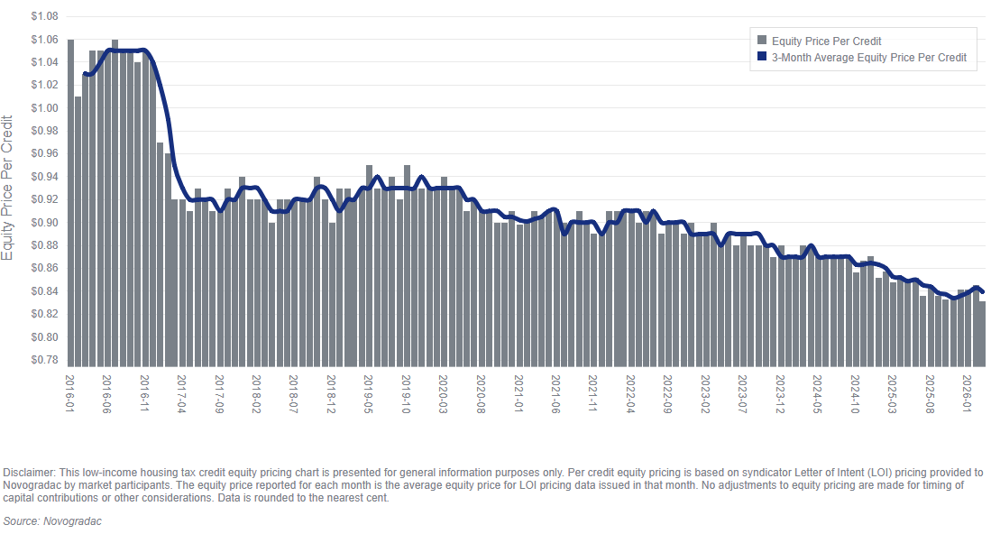
Housing Credit Equity Dynamics

Slide 21
How Could Pricing Rebound?
Accomplished
100% bonus depreciation
Termination/expedited phase out of energy credits
Increase GSE LIHTC investment cap (from $1 billion to $2 billion each)
Proposals and Ideas Under Consideration
Raise the Public Welfare Investment cap (21st Century ROAD to Housing Act)
Lower LIHTC risk rating in bank capital standards (Basel III comments due June 18)
Extend carryback period to 5 years (possible addition to AHCIA; standalone carryback bill)
Allow Housing Credit investments to further reduce 38(c)(1)(B) limitation threshold (possible addition to AHCIA)

Slide 22
AHCIA Highlights (S. 1515 / H.R. 2725)
Comprehensive legislation to strengthen
and expand the Housing Credit.
Previous AHCIA victories include:
Lowering bond financing threshold to 25%
(2025)
Increasing the annual credit allocation by
12% (2025)
Repealing basis adjustments when the
Housing Credit and Certain energy tax incentives are used together (2021)
Setting a minimum 4 percent floor for bond-financed Housing Credit properties (2020)
Establishing the Average Income Test minimum set-aside (2018)
169 House Cosponsors (85 Republicans/84 Democrats); 67 percent of Ways and Means Committee
42 Senate Cosponsors (21 Republicans/21 Democrats; 59 percent of Finance Committee

Slide 23
AHCIA Highlights
Done: Lowers the bond “financed-by” threshold from 50 to 25 percent.
Partially Done: Expands the Housing Credit volume cap by 50 percent above the current level.
Allows states to award a 30 percent basis boost to Housing Bond-financed developments.
Establishes a 50 percent basis boost for units reserved for ELI households in properties that reserve at least 20 percent of units for ELI households.
Expands multifamily Housing Bond recycling authority.

Slide 24
AHCIA Highlights
Makes the Credit a more effective tool for preservation.
Enables the Credit to better serve hard-to-reach communities through basis boosts for rural, Native American, high-poverty, and high-cost communities.
Streamlines program rules like the student rule and requirements related to casualty loss and AIT in bond-financed properties.
Ensures protections for veterans and survivors of domestic violence, dating violence, and human trafficking.

Slide 25

AHCIA: Next Phase
Bill has not changed materially in over five years.
ACTION proposed new provisions and revisions to existing provisions, all with consensus approval.
Negotiations are ongoing between bill leads and their staffs.
Bill leads ultimately decide what changes to make.
Notes:
Increased investor appetite
Further streamline program implementation
And more
Including:
10-year rule
Related party rule
Modifying homeless student provision
Accessibility basis boost
Bond recycling
Bill leads also need to identify replacements for Rep. Feenstra (retiring) and possibly Sen. Blackburn (running for governor but not up for reelection in Senate).

Slide 26
NCSHA Homeownership Tax Priorities
Expand the reach of Mortgage Revenue Bonds (MRBs): Remove MRBs from the Private Activity Bond volume cap. Legislation soon to be introduced in the House by Representatives LaHood (R-IL), B. Moore (R-UT), Panetta (D-CA); Senate bill TBD
Affordable Housing Bond Enhancement Act (S.1511 / H.R.7414): Sponsored by Senators Cortez Masto (D-NV) and Cassidy (R-LA) and Representatives Yakym (R-IN) and G. Moore (D-WI) strengthens the MRB and Mortgage Credit Certificate programs to expand homeownership access to low- and moderate-income home buyers.
Neighborhood Home Investment Act (S.1686 / H.R.2854): Sponsored by Senators Young (R-IN) and Warner (D-VA) and Representatives Kelly (R-PA) and Larson (D-CT), authorizes the Neighborhood Homes Credit for production of single-family affordable housing with focus in distressed areas. Modeled on the Housing Credit, the Neighborhood Homes Credit would help potential buyers become homeowners and revitalize communities.

Slide 27
Opportunities for Tax Legislation
OPTION 1: Partisan tax bill through reconciliation process
  Reconciliation review:
    Requires Congress to pass a budget resolution;
    Can pass Senate with simple majority (no filibuster);
    Must have a budgetary impact or impact debt limit;
    Deficit neutrality after 10-year budget window
  Increased interest from congressional Republicans in doing another reconciliation bill to address DHS funding, other priorities. Scope of bill TBD.
  Would require almost complete party unanimity given narrow margin in the House
OPTION 2: Bipartisan tax bill
  Some “tax extenders” need extending
  Lame Duck session most likely opportunity
OPTION 3: No tax bill this year

Slide 28


Join the ACTION Campaign!
Get involved with us!
The ACTION Campaign
rentalhousingaction.org
Notes:
There are several ways we are working through ACTION to position our Housing Credit provisions for inclusion in a year-end tax package:
Weigh in with existing AHCIA supporters on the Ways and Means and Senate Finance Committees to ask them to include Housing Credit as a priority in any tax package that moves forward in the remainder of this Congress, sharing local examples, state or district fact sheets, and other data points to convey the need and sense of urgency to take action.
Follow up with any of your Senators and Representatives who are cosponsors, but not on the either of those committees, asking them to contact their respective congressional leadership to convey support for the Housing Credit and push for legislative action before the end of this Congress.
Help build up AHCIA cosponsorship. This is especially helpful if you have Republican Senators or Representatives who may have been hesitant to cosponsor while the Housing Credit was under consideration in the partisan reconciliation package. We have strong bipartisan support on both bills and increasing those numbers is critical for our legislative push if there is a bipartisan year-end tax bill.
We are also working hard to build the ACTION Campaign membership and further broaden our advocacy strength and reach.
If you are not a member, please join. If you are a member, please encourage your partners to join. Membership is free.

Slide 29


Slide 30
Build America, Buy America
Enacted in the 2021 Infrastructure Investment and Jobs Act
Requires manufactured products and construction materials used in federally funded infrastructure projects to be produced in the U.S.
HUD applied BABA to its affordable housing programs
Causing major problems for affordable housing development
  Costly
  Time-consuming
  Broken implementation/waiver process
  Resulting in developers turning back HUD funds

Slide 31
Build America, Buy America
Housing organizations proposal to fix BABA:
Temporarily suspend BABA implementation for affordable housing until new process is in place
Federal government should analyze the existing domestic manufacturing capacity/availability of products and materials commonly used in affordable housing production
General waiver for all materials/products determined to be unavailable, insufficiently available, or overly costly from U.S. sources
Create database of BABA-eligible materials
Streamline purchasing requirements
Increase the de minimus waiver percentage to at least 10%
HUD/OMB review of waivers within 30 days of receipt

Slide 32
Build America, Buy America
Paths forward
Administrative action: Administration could fix this without Congressional action. Expecting a request for information soon
Legislative action:
  Standalone legislation: Housing and Insurance Subcommittee Chair Flood (R-NE) expected to introduce legislation soon requiring HUD to study and improve BABA implementation; stays BABA application until 60 days after study completed and report provided to Congress; requires HUD/OMB action on waivers within 90 days of receipt
  Appropriations: Spending bills could direct Administration to revise BABA (House THUD bill has BABA language in it)
  21st Century/ROAD: House bill directs HUD to review and revise BABA guidance for HOME program

Slide 33
Key Executive and Regulatory Actions
Housing EO (Mar. 13)
Mostly focused on attainability of homeownership
Directs numerous federal agencies to publish regs and reform program implementation to make home construction easier
Bank Capital Requirements (Basel III) (Mar. 19)
Federal banking regulators published new version of Basel III regulatory proposal; comments due June 18
NCSHA and other affordable housing industry groups to recommend lower risk weighting of LIHTC to 20% (if not 20%, risk rating should be no more than 50%)

Slide 34
Pending HUD Regulations of Import
Verification of Eligible Status (AKA Mixed Status Rule): Requires verification of citizenship/eligible immigration status of all applicants and recipients of HUD assistance for covered programs, removing current prorated assistance policy (comments were due April 21, final rule pending publication)
Revocation of 30-Day Notification Requirement Prior to Termination of Lease for Nonpayment of Rent: Reinstates prior notification requirements (5 to 30 days depending on the program) rather than 30-day requirement put in place under previous Administration (Interim final rule effective March 30, comments were due April 27)

Slide 35
Pending HUD Regulations of Import
Establishing Flexibility for Implementation of Work Requirements and Term Limits: Allows PHAs and Multifamily Housing Owners option to implement work requirements for work-eligible adults and term limits for non-elderly, non-disabled families in public housing and recipients of rental assistance (HCV, PBV, and PBRA) (comments were due May 1; final rulemaking pending publication)
Equal Access to Housing in HUD Programs: Removes references to “gender” and “gender identity” from HUD regulations and replaces with “sex”; allows for sex-specific facilities such as emergency shelters (comments due June 29)

Slide 36

Questions?
?
Stay Connected
Jennifer Schwartz, Director of Tax and Housing Advocacy
LinkedIn: https://bit.ly/3PRDLfg
jschwartz@ncsha.org | 202-624-7758
Save the Dates
Implementing BABA in Affordable Housing Training
June 18, 2026 1:00 – 5:00 ET | Virtual
Annual Conference & Showplace*
October 3 – 6, 2026 | Detroit, MI
The HFA Institute
January 10 – 15, 2027 | Washington, DC
*NCSHA Members-Only Event. Join at ncsha.org.

