Slide 1


Slide 2


Slide 3
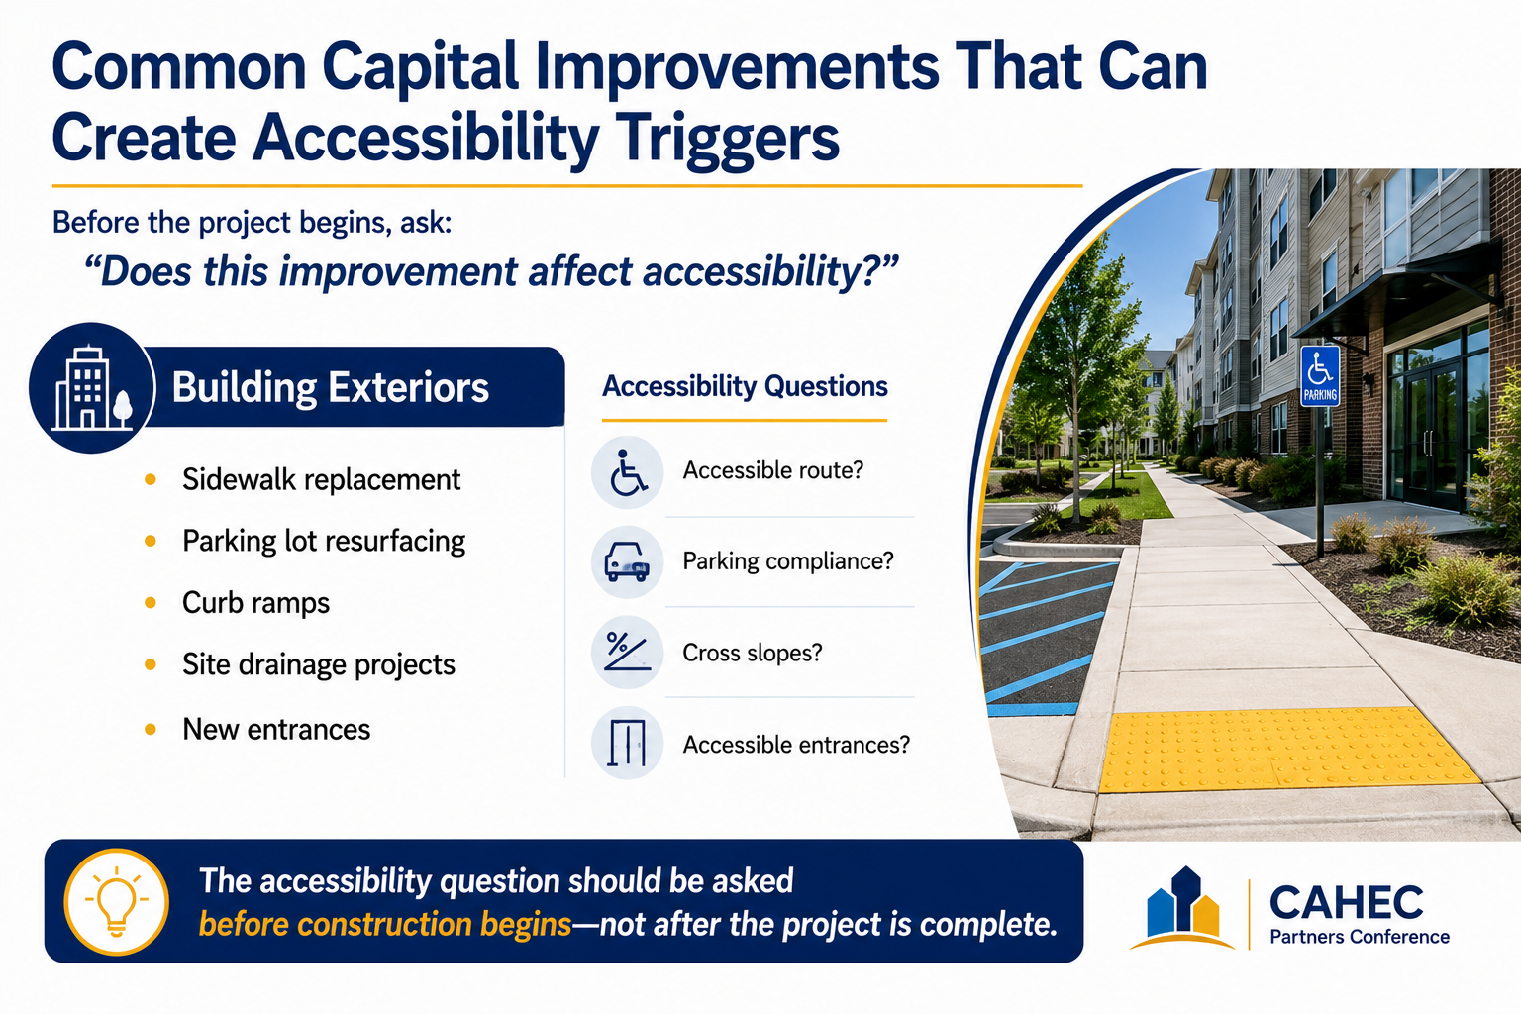

Slide 4
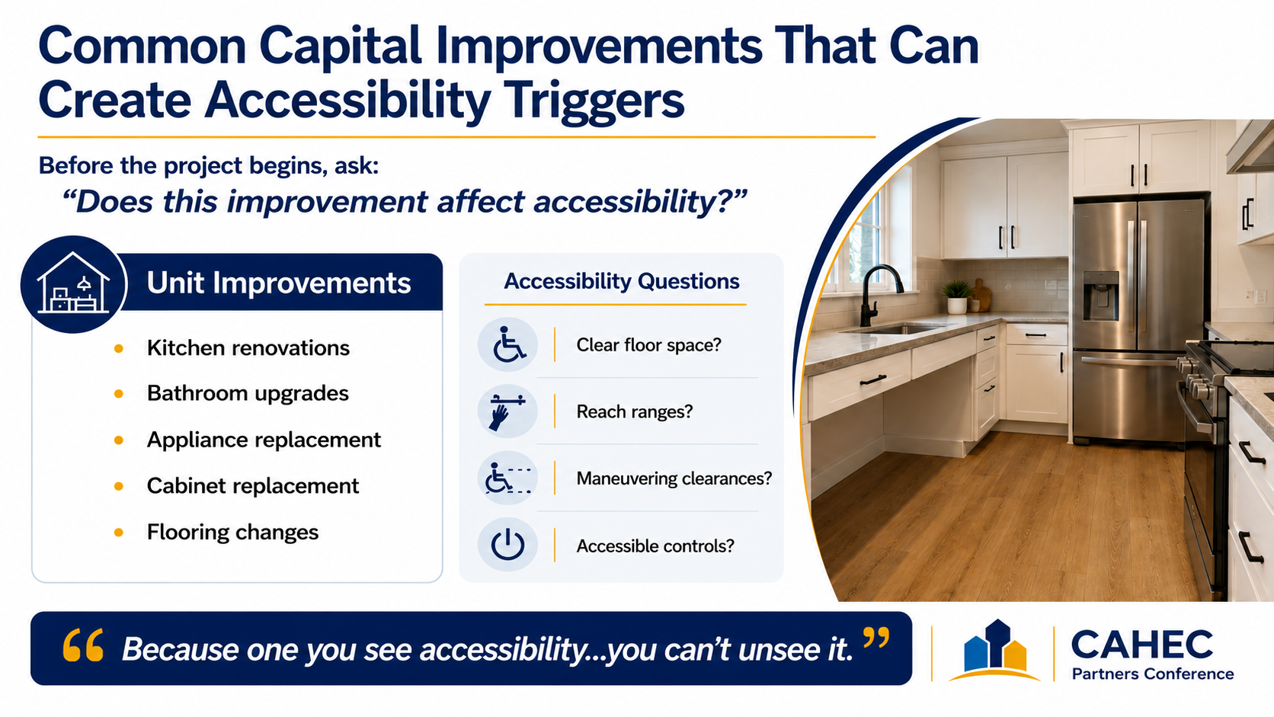

Slide 5
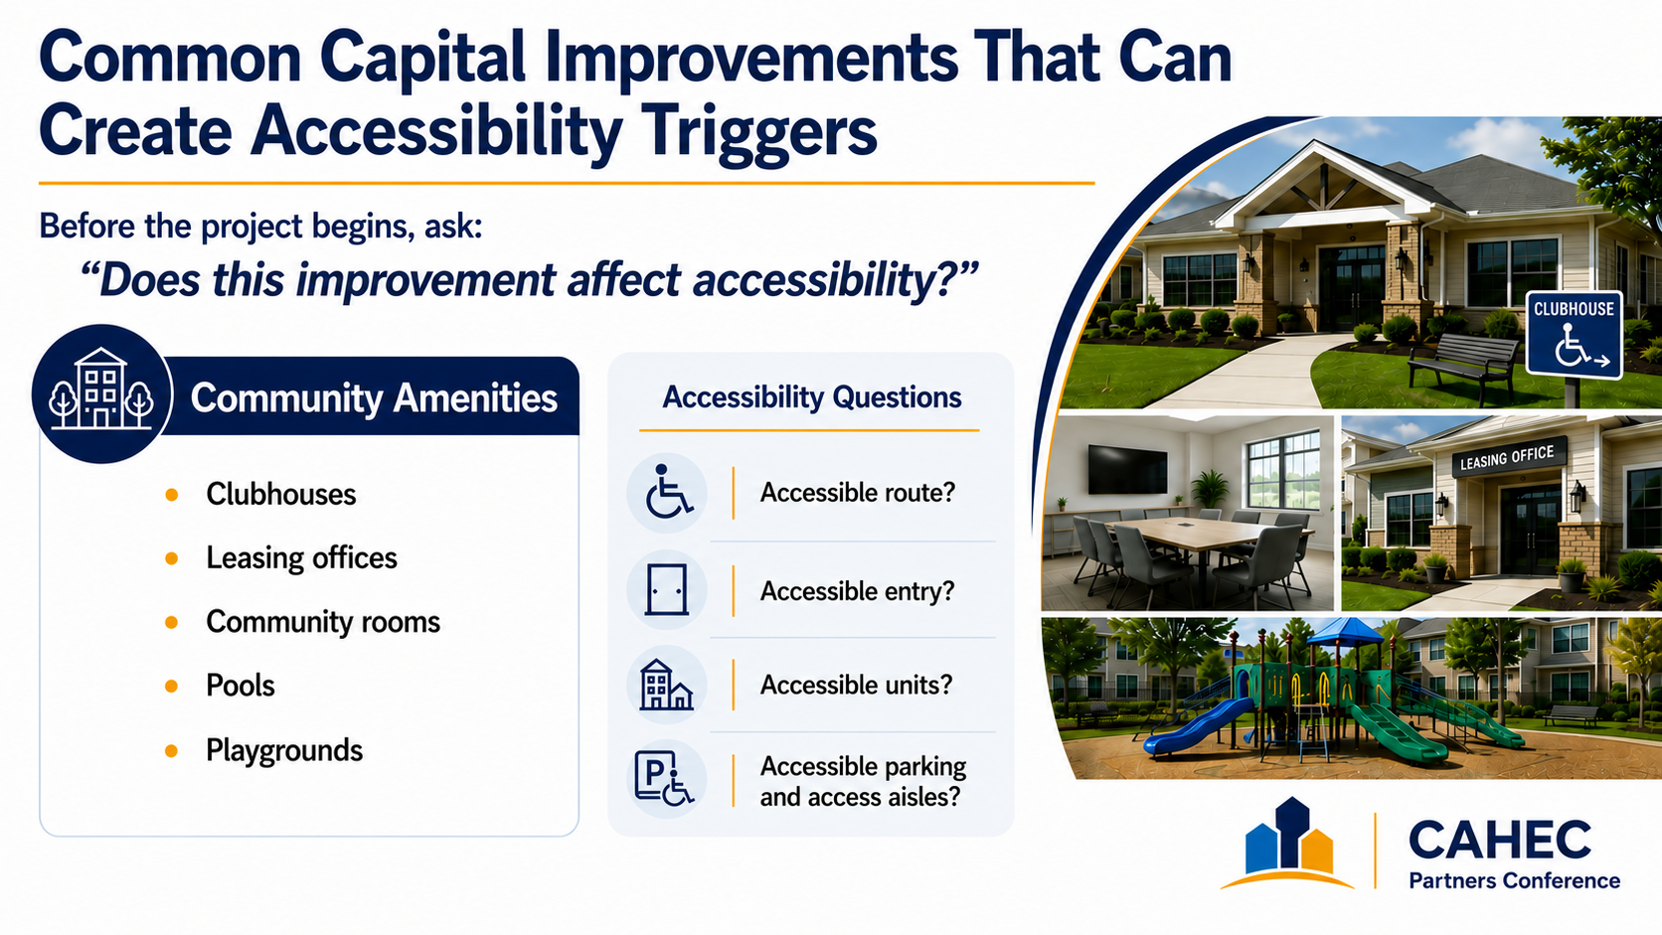

Slide 6


Slide 7

50 years ago (1976) there was a movie that had a theme that still applies today regarding
accessibility

Slide 8
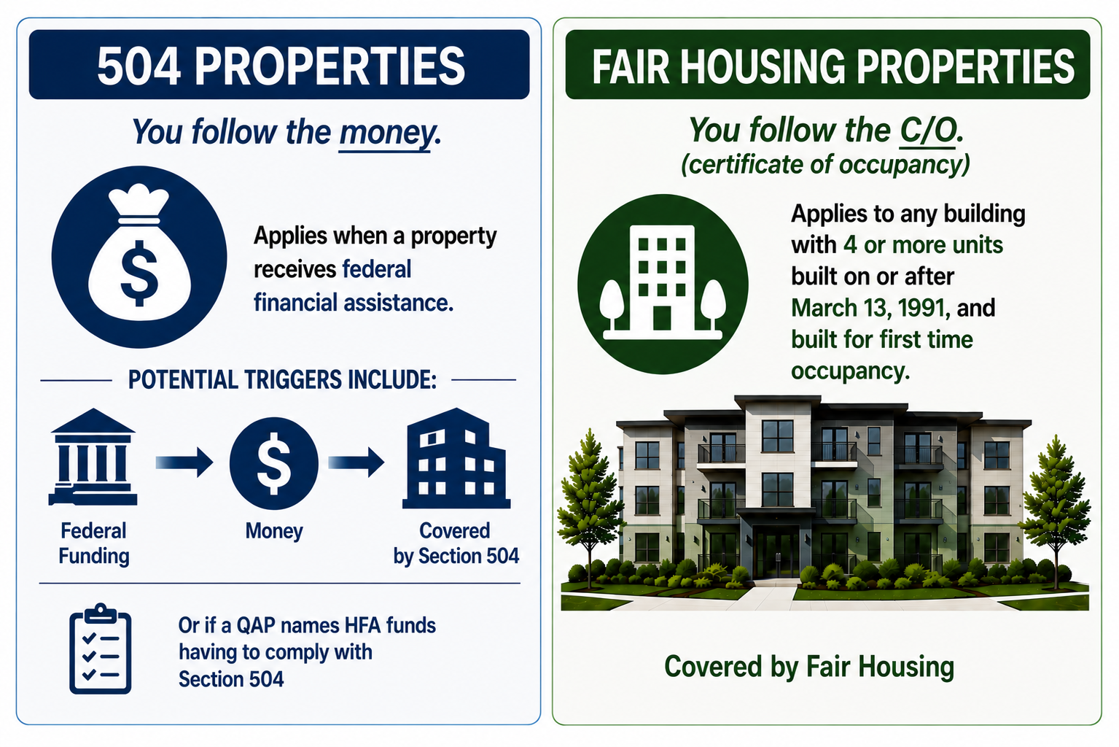

Slide 9
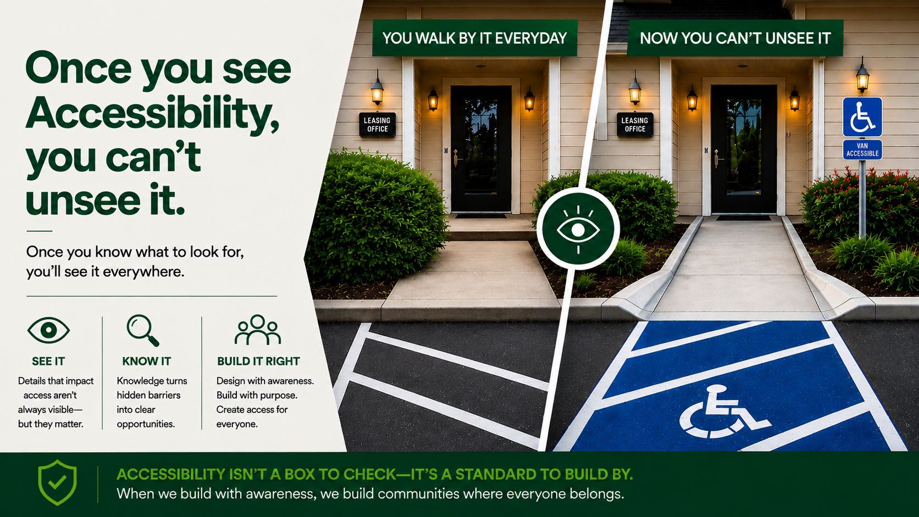

Slide 10
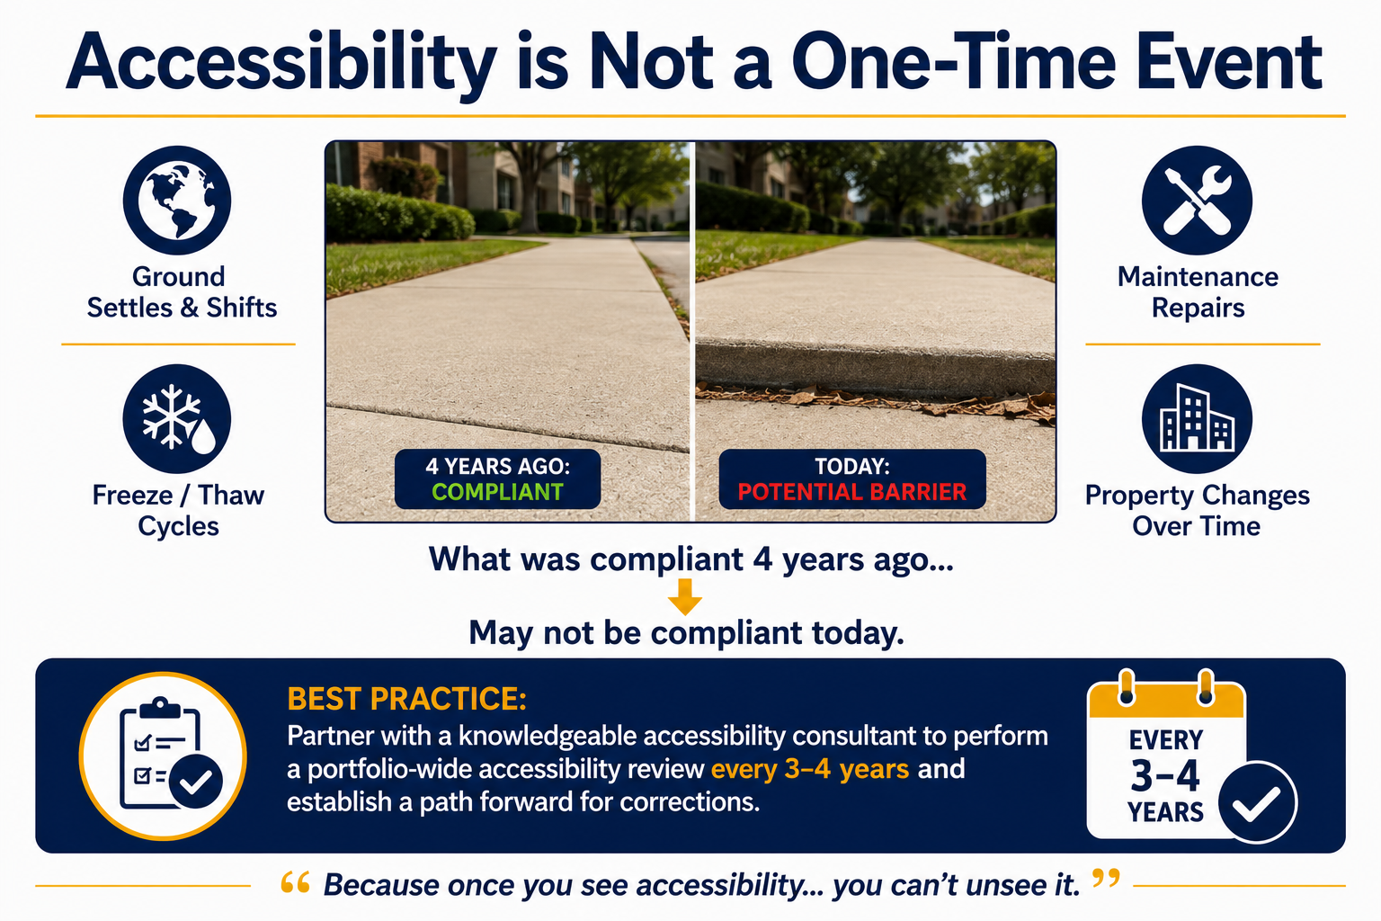

Slide 11
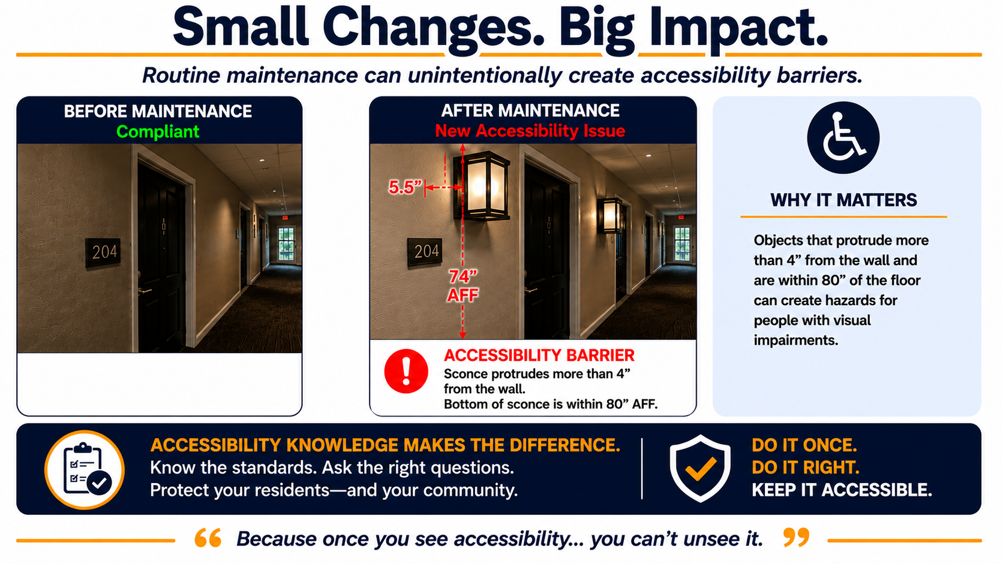

Slide 12
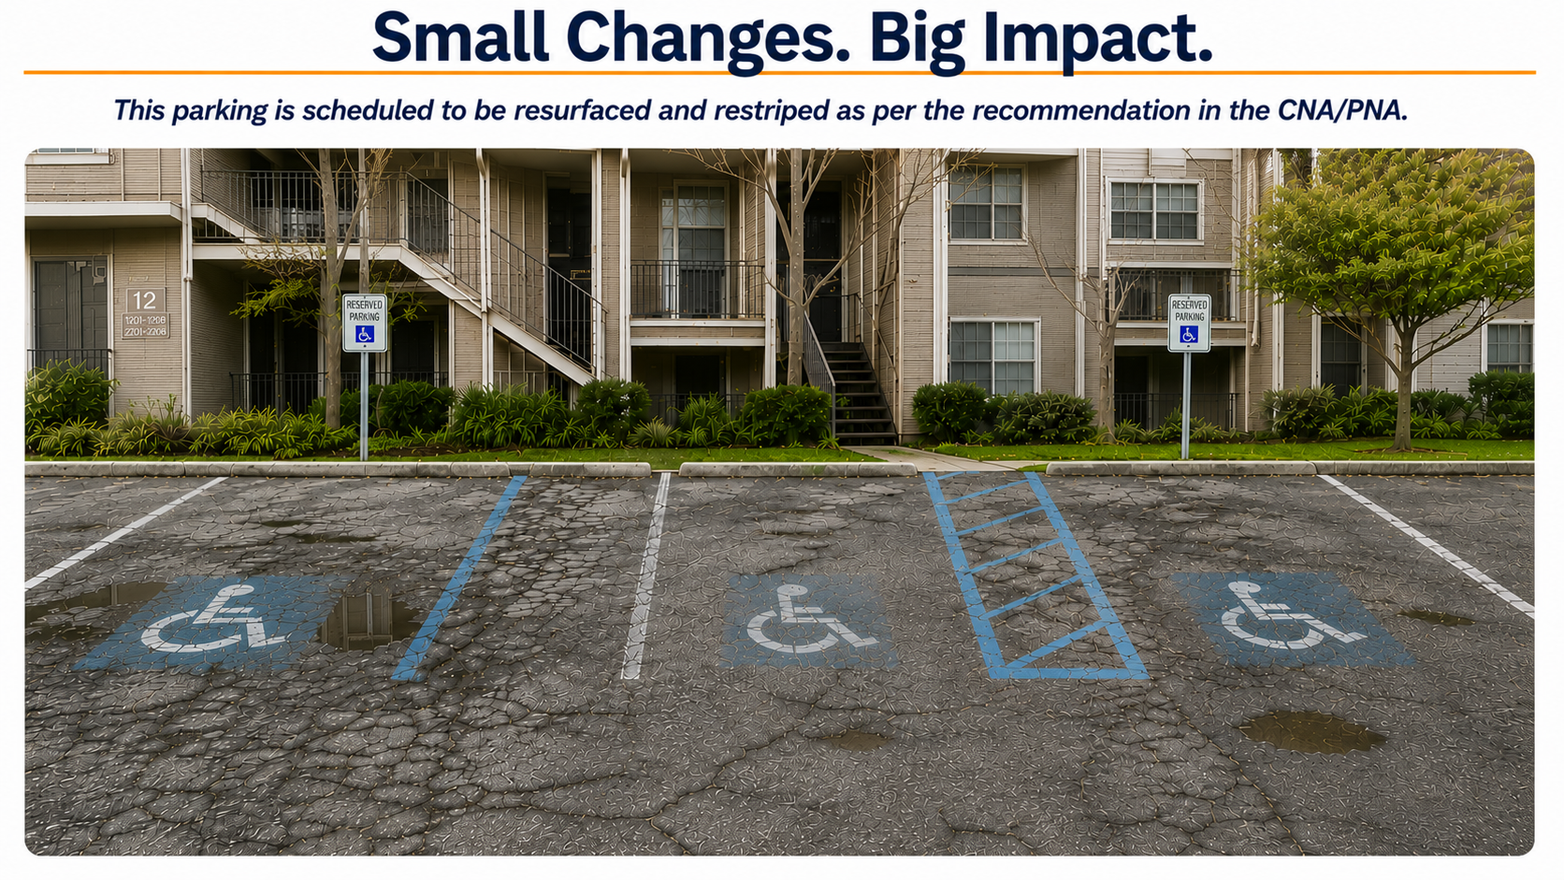

Slide 13
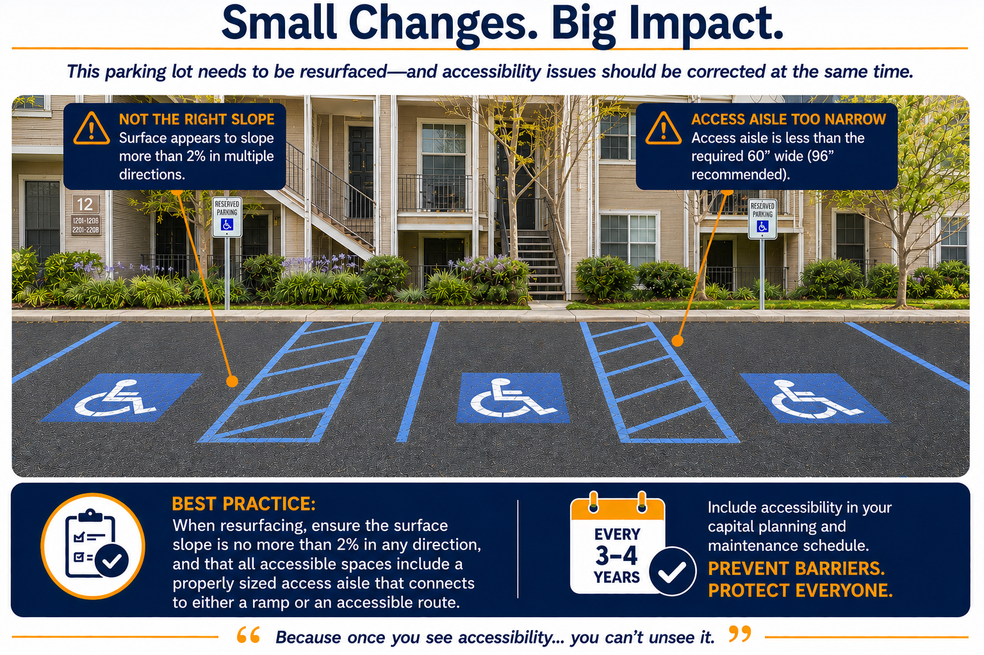

Slide 14
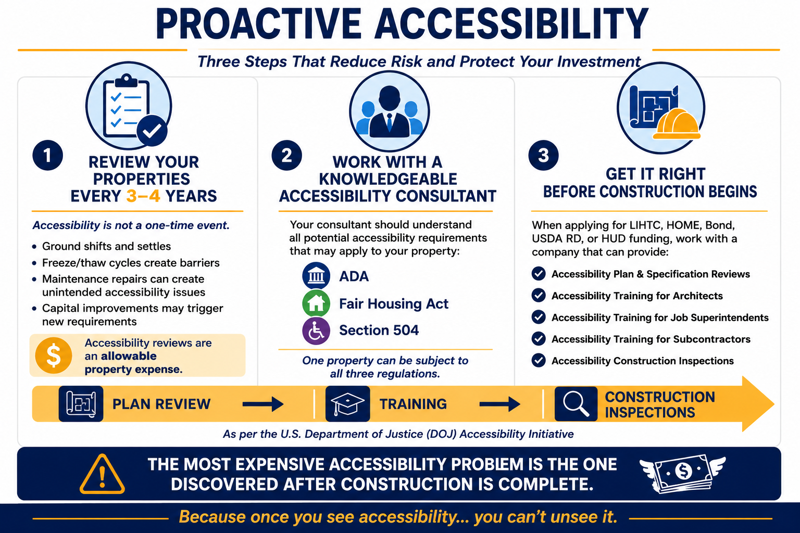

Slide 15

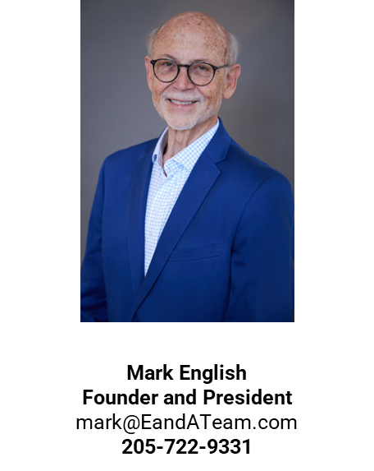
The information contained in the following PowerPoint presentation is the sole property of E&A Team, Inc. Redistribution or unauthorized use of this content without the expressed written consent of E&A Team, Inc is prohibited. © 2026
Notes:
Breaks / Changes in Speakers:
Mark slides 1 – 104
Josh: slides 105-205

