Slide 1

The Operating Expense Safari: Hunting for Savings with Tax Abatement Strategies

Slide 2

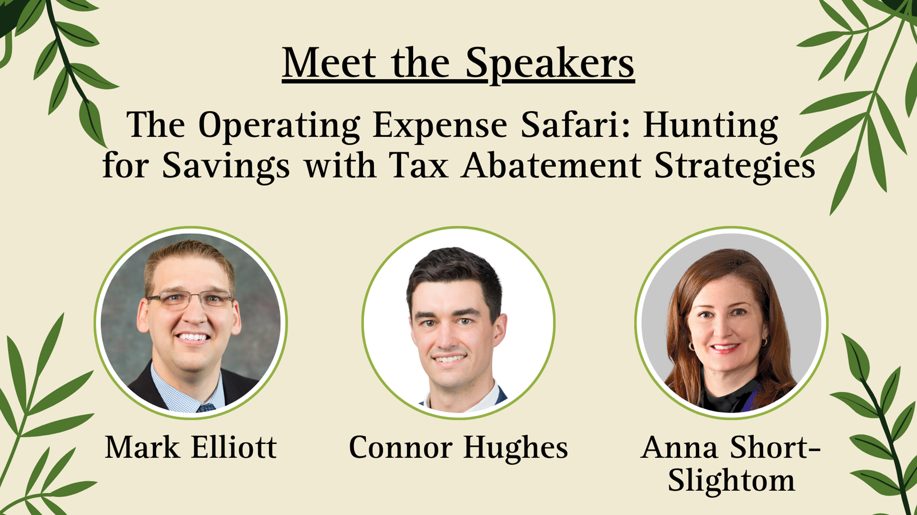
Tax Abatement Overview

Slide 3
North Carolina:
All property is subject to taxation unless it is excluded or exempt by statute or by the NC Constitution
N.C. Gen. Stat. Section 105-278.6(a)(8) provides one such exemption for real property owned by a nonprofit that provides housing for low or moderate income individuals or families
N.C. Gen. Stat. Section 105-278.6(e) clarifies that property exempt pursuant to (a)(8) can be a future site for housing as long as the housing is constructed within 10 years, and taxes are treated as deferred during that time

Slide 4
North Carolina (cont.):
“Owned” not defined in statute, so we look to case law
Holding legal title is not the determinative factor; can be indirectly owned by a nonprofit, as long as ownership “ultimately vests” in a nonprofit entity
If the nonprofit’s ownership interest is less than 100% (e.g., 0.1% or 0.01%), then we look to “other factors indicative of ownership”
Factors may include:
      (i) control of the property
      (ii) role as trustee
      (iii) ROFR
      (iv) the intent of the parties

Slide 5
North Carolina (cont.):
Practically: Not automatic!
Must apply to the local county tax office by January 31 of the year after acquiring ownership
Typically involves filing Form AV-10 but dependent on county
Initial determination lies with the county

Slide 6
NC Recent Events: House Bill 1042
Narrows the definition of “ownership”
Nonprofits who partner with For-Profits (like the court found permissible in Blue Ridge) would be required to include some type of governmental funding to ensure affordability
If not financed with governmental funding, then the property must be 100% owned and operated by a nonprofit that has owned and operated affordable rental housing for at least five years!
No leases and no funding or financial assistance from a for-profit organization
Owners already exempt under 105-278(6)(a)(8) must reapply
May 2026: NC House voted unanimously to advance House Bill 1042 and is now pending in the Senate

Slide 7
NC Recent Events: Constitutional Amendment!
NCGA passed legislation on May 20
Voters will decide on a constitutional amendment that would allow the legislature to limit how much counties can increase the revenue they collect from property taxes from year to year
Cap on the total revenue the county can collect, regardless of property value
Will appear on the November 2026 ballot
Legislature won’t actually begin discussions on what this will look like until 2027 legislative session

Slide 8
SC Nonprofit Affordable Housing Tax Exemption + New Moratorium
How it works (§ 12-37-220(B)(11)(e))
• Full property tax exemption for nonprofit-owned low-income housing
• Must meet IRS Rev. Proc. 96-32 safe harbor (≤80% AMI)
• Nonprofit as managing member; pairs with LIHTC, agency debt, OZ equity
• Removes the largest recurring operating cost, makes deals pencil
The bill: S. 853 (signed May 19, 2026)
• Started as an abandoned buildings bill; exemption added by late floor amendment
• Temporary freeze: no final SCDOR approval for applications filed on or after June 30, 2026
• Applications held in abeyance, not denied; freeze expires June 30, 2027
• Grandfathered: existing exemptions and anything filed before June 30, 2026

Slide 9
The bill: S. 853 (signed May 19, 2026)
• Started as an abandoned buildings bill; exemption added by late floor amendment
• Temporary freeze: no final SCDOR approval for applications filed on or after June 30, 2026
• Applications held in abeyance, not denied; freeze expires June 30, 2027
• Grandfathered: existing exemptions and anything filed before June 30, 2026
Impact
• June 30, 2026 is now a hard filing deadline
• Estimated $600MM in Affordable housing now in jeopardy
• Agency lending costs going up for affordable
• Capital markets now view SC Affordable housing a uninvestable.
• Likely want to see S125 Passed (100% of units at 80% AMI to qualify)

Slide 11
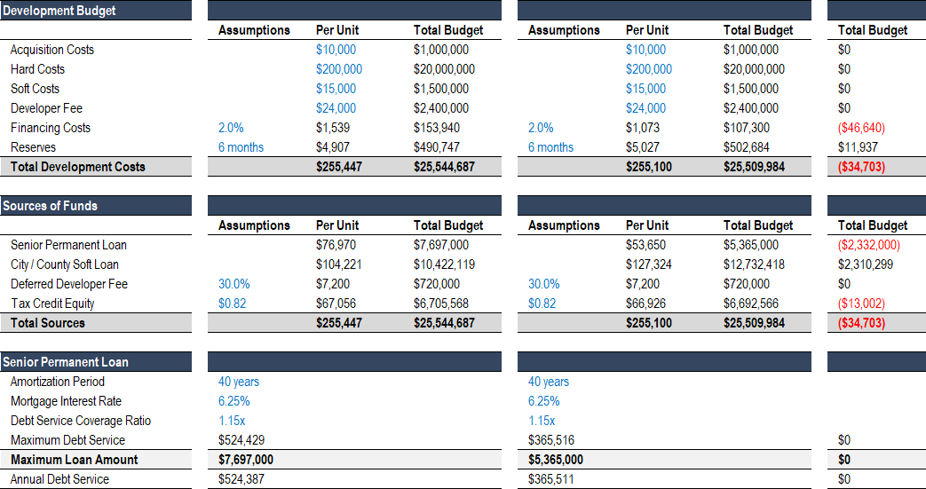

Slide 12
Question and Answer

Slide 13
Thank you for Attending!

